Slide 1
CIND820 - Big Data Analytics Project Machine Learning Algorithms to Predict Income Level: A Comparative Study
Syeda Sunjida Aleya 500467980
Supervisor: Dr. Tamer Abdou

Slide 2
Theme of The Project
Since 19th century, worldwide income inequality has been constantly increasing. Governments of different countries have been trying their best to address this problem and to provide an optimal solution.
Researchers commonly analyze income distributions based on gender, ethnicity, geographic location, age, occupation, education, historical income etc.
Based on this topic, the theme of this project is Classification and Predictive Analytics.

Slide 3
Research questions
Following the literatures on U.S. Census Income and on different machine learning algorithms three research questions are the focus of this project:
What are the major factors effecting the income levels?
Which feature selection technique gives the best set of features?
• Which is the best model based on efficiency, effectiveness, and
stability measures?

Slide 4
Data Source and Initial Cleaning
This project would inspect the Current Population Survey Annual Social and Economic Supplement (ASEC) dataset, 2022 taken from U.S. Census Bureau website.
Following previous studies, 40 (8 numeric and 32 categorical) demographic and employment related variables are selected.
In the initial cleaning, following the “Public Use Benchmarks” of U.S. Census Bureau, people without income were excluded. Also, after removing negative incomes the dataset contains 106,534 instances.

Slide 5
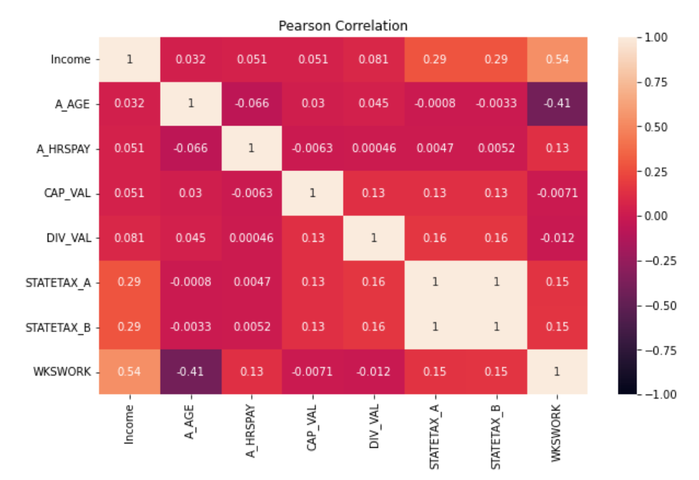
Exploratory Data Analysis
A detail Exploratory Data Analysis has been done with Panda Profiling.
Univariate Analysis : Histograms and Bar graphs
Bivariate Analysis : Pearson and Spearman's Correlation

Slide 6
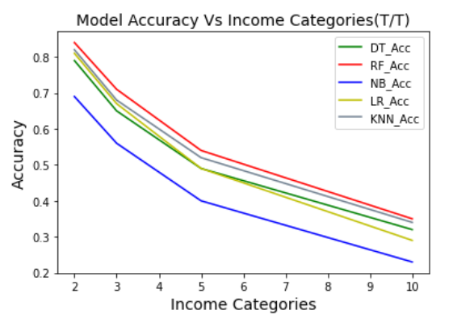
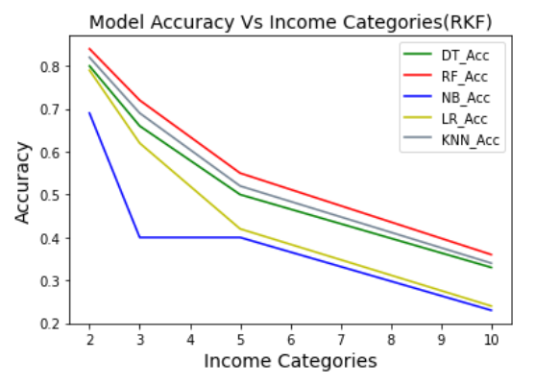
Preparing Target Variable “Income”
Converted the dependent variable into categorical applying quantile method.
Created 2, 3, 5 and 10 categories of the target variable.
Applied five different classification algorithms: Decision Tree, Random Forest, KNN, Naive Bayes, and Logistic Regression..
The optimum number of income categories is two categories (“Low” and “High”).

Slide 7
Feature Engineering
Three Feature Selection Methods applied:
1) Filter method:
Missing Value Ratio (MVR)
Mutual Information Gain (MIG)
Low Variance Filter (LVF)
Correlation Coefficient (CC)
2) Wrapper method (Forward Selection)
3) Embedded method (Sequential Feature Selection)

Slide 8
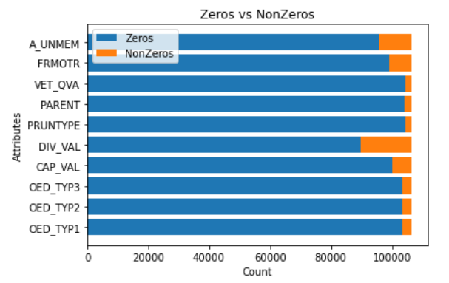
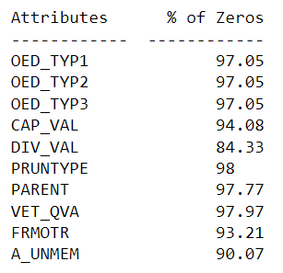
Filter method- Missing Value Ratio (MVR)
10 attributes has above 90% missing values.

Slide 9
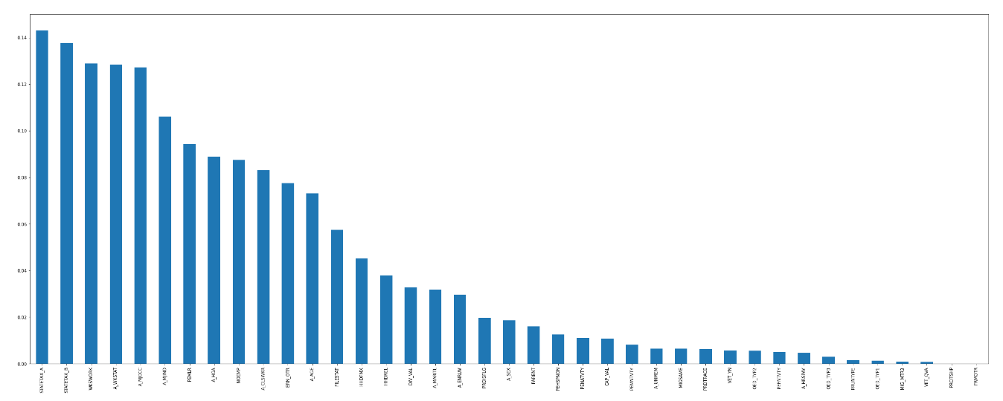
Filter method- Mutual Information Gain (MIG)
24 attributes are selected where MI >= 0.01

Slide 10
Filter method - Low Variance Filter (LVF)
Threshold >= 0.0001, 19 attributes for further studies
Filter method - Correlation Coefficients (CC)
Removing highly correlated 16 attributes (ideally >0.75),
23 attributes left.
Wrapper Method - Forward Selection (FS)
FS selected 29 attributes, but "PRDTRACE" & "PENATVTY" are dropped because of insignificant coefficients.
Embedded Method - Sequential Forward Selection (SFS) Based on RF Classifier selected 29 attributes.

Slide 11
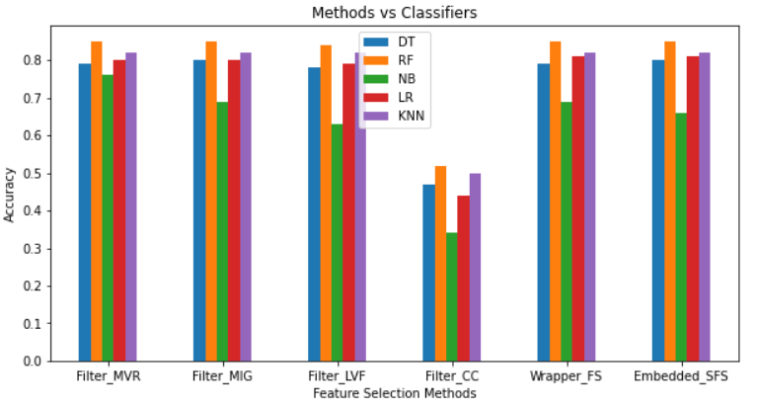
Comparing Feature Selection Methods
Effectiveness:
The accuracy and MCC for all models are similar for each method, except filter method based on removing highly correlated attributes (for both T/T split and RepeatedKfold CV).
All the models performing poor on this subset implies that, the highly correlated attributes most likely providing some independent information that our models can use for training.

Slide 12
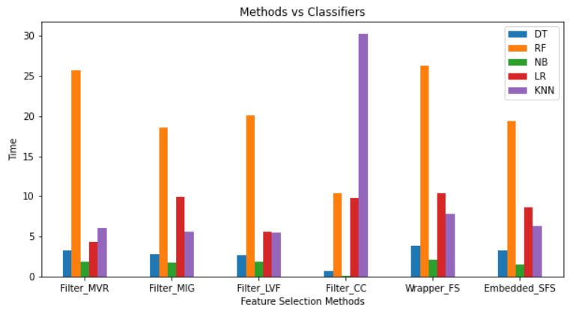
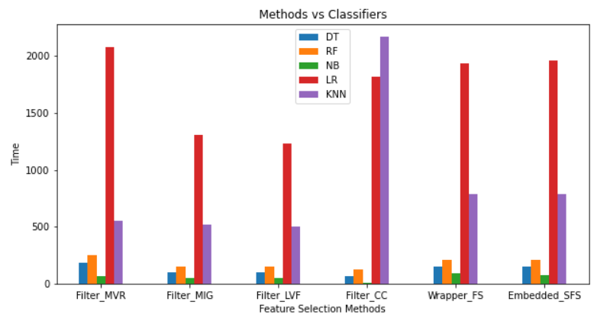
Efficiency: The efficiency measure “Run Time” shows little different picture here.
Naïve Bayes is best on filter method (CC). Same goes for Decision tree and Random Forest.
KNN took longest time on filter method (CC) and worked fastest on the filter method (LVF).
In case of Logistic Regression, fastest on filter method (MVR) and (LVF).
T/T Split RepeatedKFold

Slide 13
Stability:
Random Forest worked best on MIG, Wrapper and Embedded (85% and 84%), slightly better on Embedded, MCC (71% and 68%) on T/T split and RKF CV respectively.
On the other hand, Naïve Bayes is best on Filter method (MIG).
DT, KNN, and LR are consistently sable on all the subsets except the one based on filtering highly correlated attributes.

Slide 14
Top Features Selection
Top16 attributes are selected to implement the models.
This selection is based on the Feature Selection methods.
5 attributes (A_HGA, A_MJOCC, STATETAX_B, HHDFMX, and NOEMP) are selected by all the methods.
The rest 11 attributes (PEHSPNON, PEMLER, A_SEX, A_AGE, A_MJIND, CAP_VAL, DIV_VAL, STATETAX_A, A_CLSWKR, A_WKSTAT, and WKSWORK) are selected by 5 tests out of 6.

Slide 15
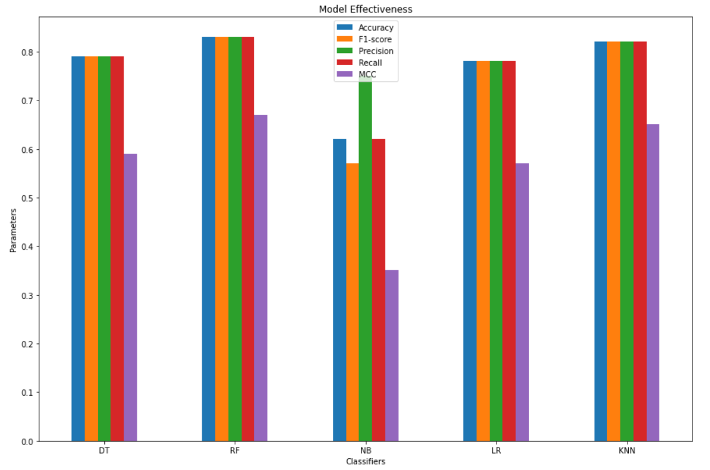
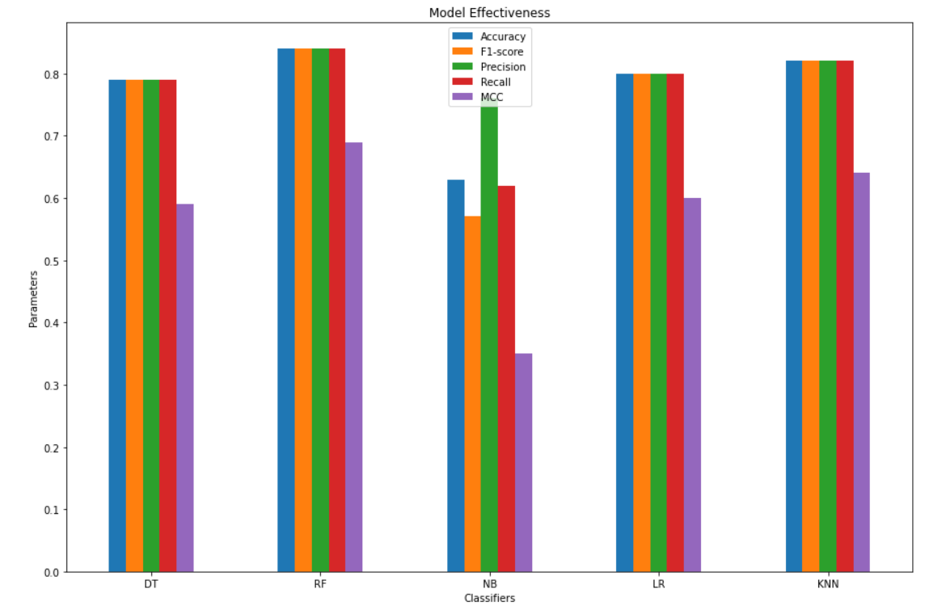
Comparison of Machine Learning Algorithms
The Accuracy of Random Forest is the best among all the five classifiers (in both T/T Split and RKF). Same goes for Precision, Recall, F1-score, and Matthew’s correlation coefficient (MCC). The effectiveness of Decision Tree, KNN, and Logistic Regression are also very close to the Random Forest. Only, Naïve Bayes had performed consistently low in all cases.
T/T Split RepeatedKFold

Slide 16
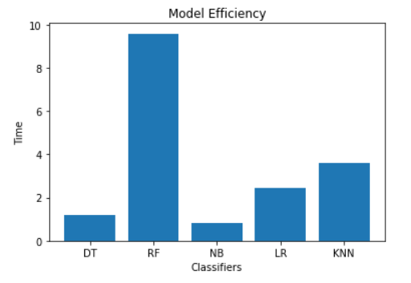
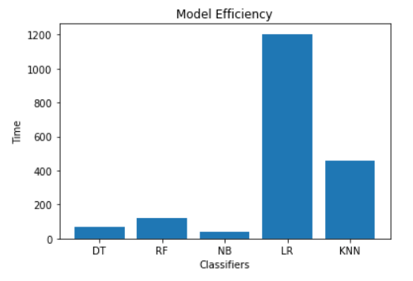
In terms of efficiency, the run time (measured in seconds) is fastest for Naïve Bayes (in both T/T Split and RKF). In case of Train-Test split, Random Forest took longest time; where as for RepeatedKFolds, Logistic Regression was the most inefficient.
T/T Split RepeatedKFold
In case of stability, we can see that all the models representing very similar performance in both Train-Test Split and RepeatedKFold cross validation techniques. This can be summarized that all these models are stable.

Slide 17
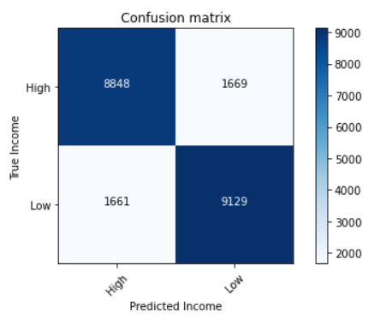
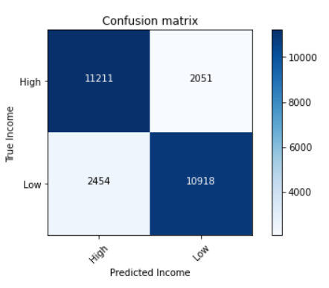
Confusion Matrix : Random Forest Classifier
Accuracy = 0.83
Error Rate = 0.17
True High Rate(Recall) = 0.85
True Low Rate(Specificity) =0.82
High Predicted Value(Precision) = 0.82
Low Predicted Value =0.84
F1-score = 0.83
MCC = 0.67

Slide 18
Conclusion & Future Improvement
The focus of this project was to investigate the most important features that effects the income levels. Some of the most important ones are:
Education, major occupation, state income tax liability, household and family status, total number of working persons, sex, age, major industry, dividends income, capital gain, class of worker, and full/part-time status.
The findings also show that removing highly correlated attributes in the Filter method is the worst performer here since all the models showed consistently low effectiveness. The models’ performance on each subgroup selected by other Feature Selection methods are similar.

Slide 19
Lastly, five machine learning algorithms were evaluated to identify the most efficient and best performing model. Five different performance metrics were used to evaluate and validate the effectiveness of the models. Random Forest is the best effective model. Even though Naïve Bayes is most efficient but low in effectiveness. In terms of stability, all the models are stable.
We can see even on the top 16 attributes, the best performer Random Forest gave accuracy, Precision, Recall, and F1-score only 84% and 83% ( and MCC 69% and 67%) for T/T Split and ReapeatedKFold respectively. To improve the effectiveness, more income related attributes can be added in the dataset from the source. In addition, instead of taking percentiles for income categories, we can try setting a threshold for income levels to achieve more effective results.

Slide 20
Thank you all for being here today and taking the time to patiently listen to my presentation. I wish you all a blessed day.

